Slide 1
Vendor Relief
Team :
Vatsal Kesarwani
Banke Bihari Agrawal
Shubhangani Tayal
Shreyans Poddar

Slide 2
Vendor Relief
Its is an app built to help people in fighting COVID-19, ‘VENDOR RELIEF’ name was given as it gives the details of the vendors who are providing services during this tough time. So that people can buy their essential stuff from them. Some of other features of this app is that it gives the real time data of COVID at global level and various states of India, and also the prevention and precautions that is essential for everyone’s safety.

Slide 3
Problem Statement
During COVID-19, people living in societies and apartments may not be aware of the nearby shops and vendors whether they are providing essential services or not (such as Groceries, Pharmacy, Dairy, etc) and if they may be providing the people may not know the details of the vendors(like timings, contact number and address of the shop).
People may be facing some doubts about covid-19.
After knowing about these problems faced by some of the people ,we have done our best to help them out.
Let’s see how……

Slide 4
Top Features of Our App
Registered Vendors can provide their shop details by signing up.
Provide details of vendors to the customers who want to buy essential products for them like(Groceries, Medicines,dairy and others ).
Give real time data of COVID at global level and state level in India(details such as number of cases in world and India, number of deaths at globally & every state of India)
Details of several essential prevention and precaution to stay safe.

Slide 5

ANDROID STUDIO
Android Studio is the official integrated development environment (IDE) for Android application development. ... To support application development within the Android operating system, Android Studio uses a Gradle-based build system, emulator, code templates, and Github integration

Slide 6

HTML,CSS AND JAVASCRIPT
HTML provides the basic structure of sites, which is enhanced and modified by other technologies like CSS and JavaScript. CSS is used to control presentation, formatting, and layout. JavaScript is used to control the behavior of different elements.Bootstrap is a free and open-source CSS framework directed at responsive, mobile-first front-end web development. It contains CSS- and JavaScript-based design templates for typography, forms, buttons, navigation, and other interface components.

Slide 7

FIREBASE
The Cloud FireStore Database is a cloud-hosted NoSQL database that lets you store and sync between your users in real-time. When your users go offline, the Realtime Database SDKs use local cache on the device to serve and store changes. When the device comes online, the local data is automatically synchronized

Slide 8
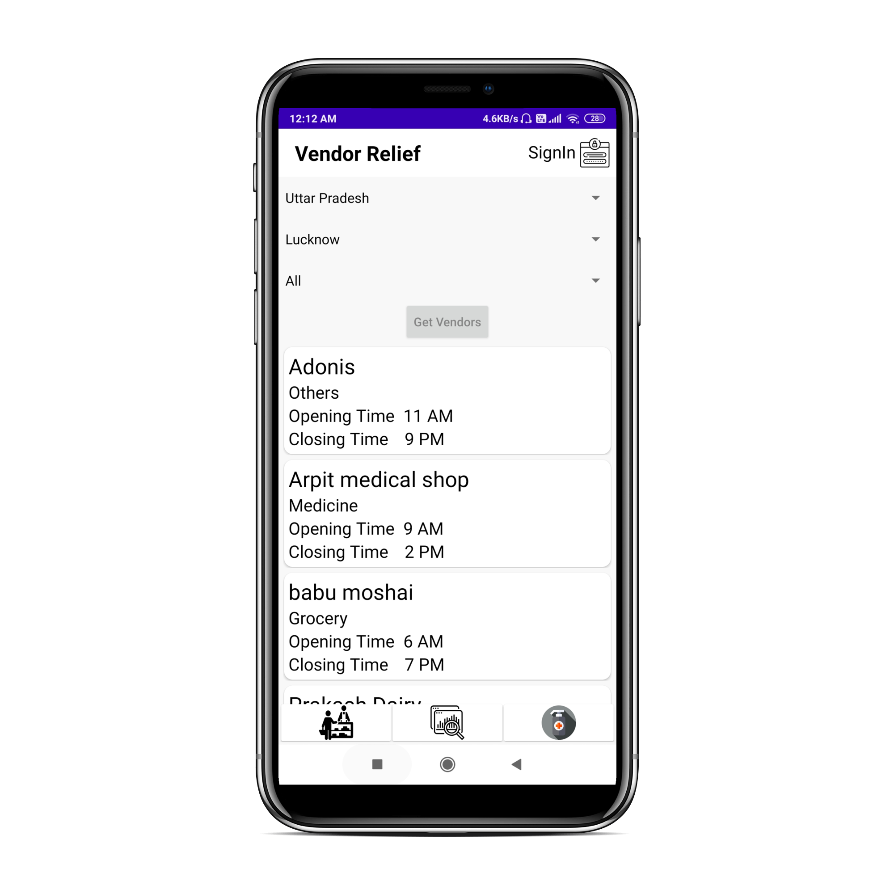
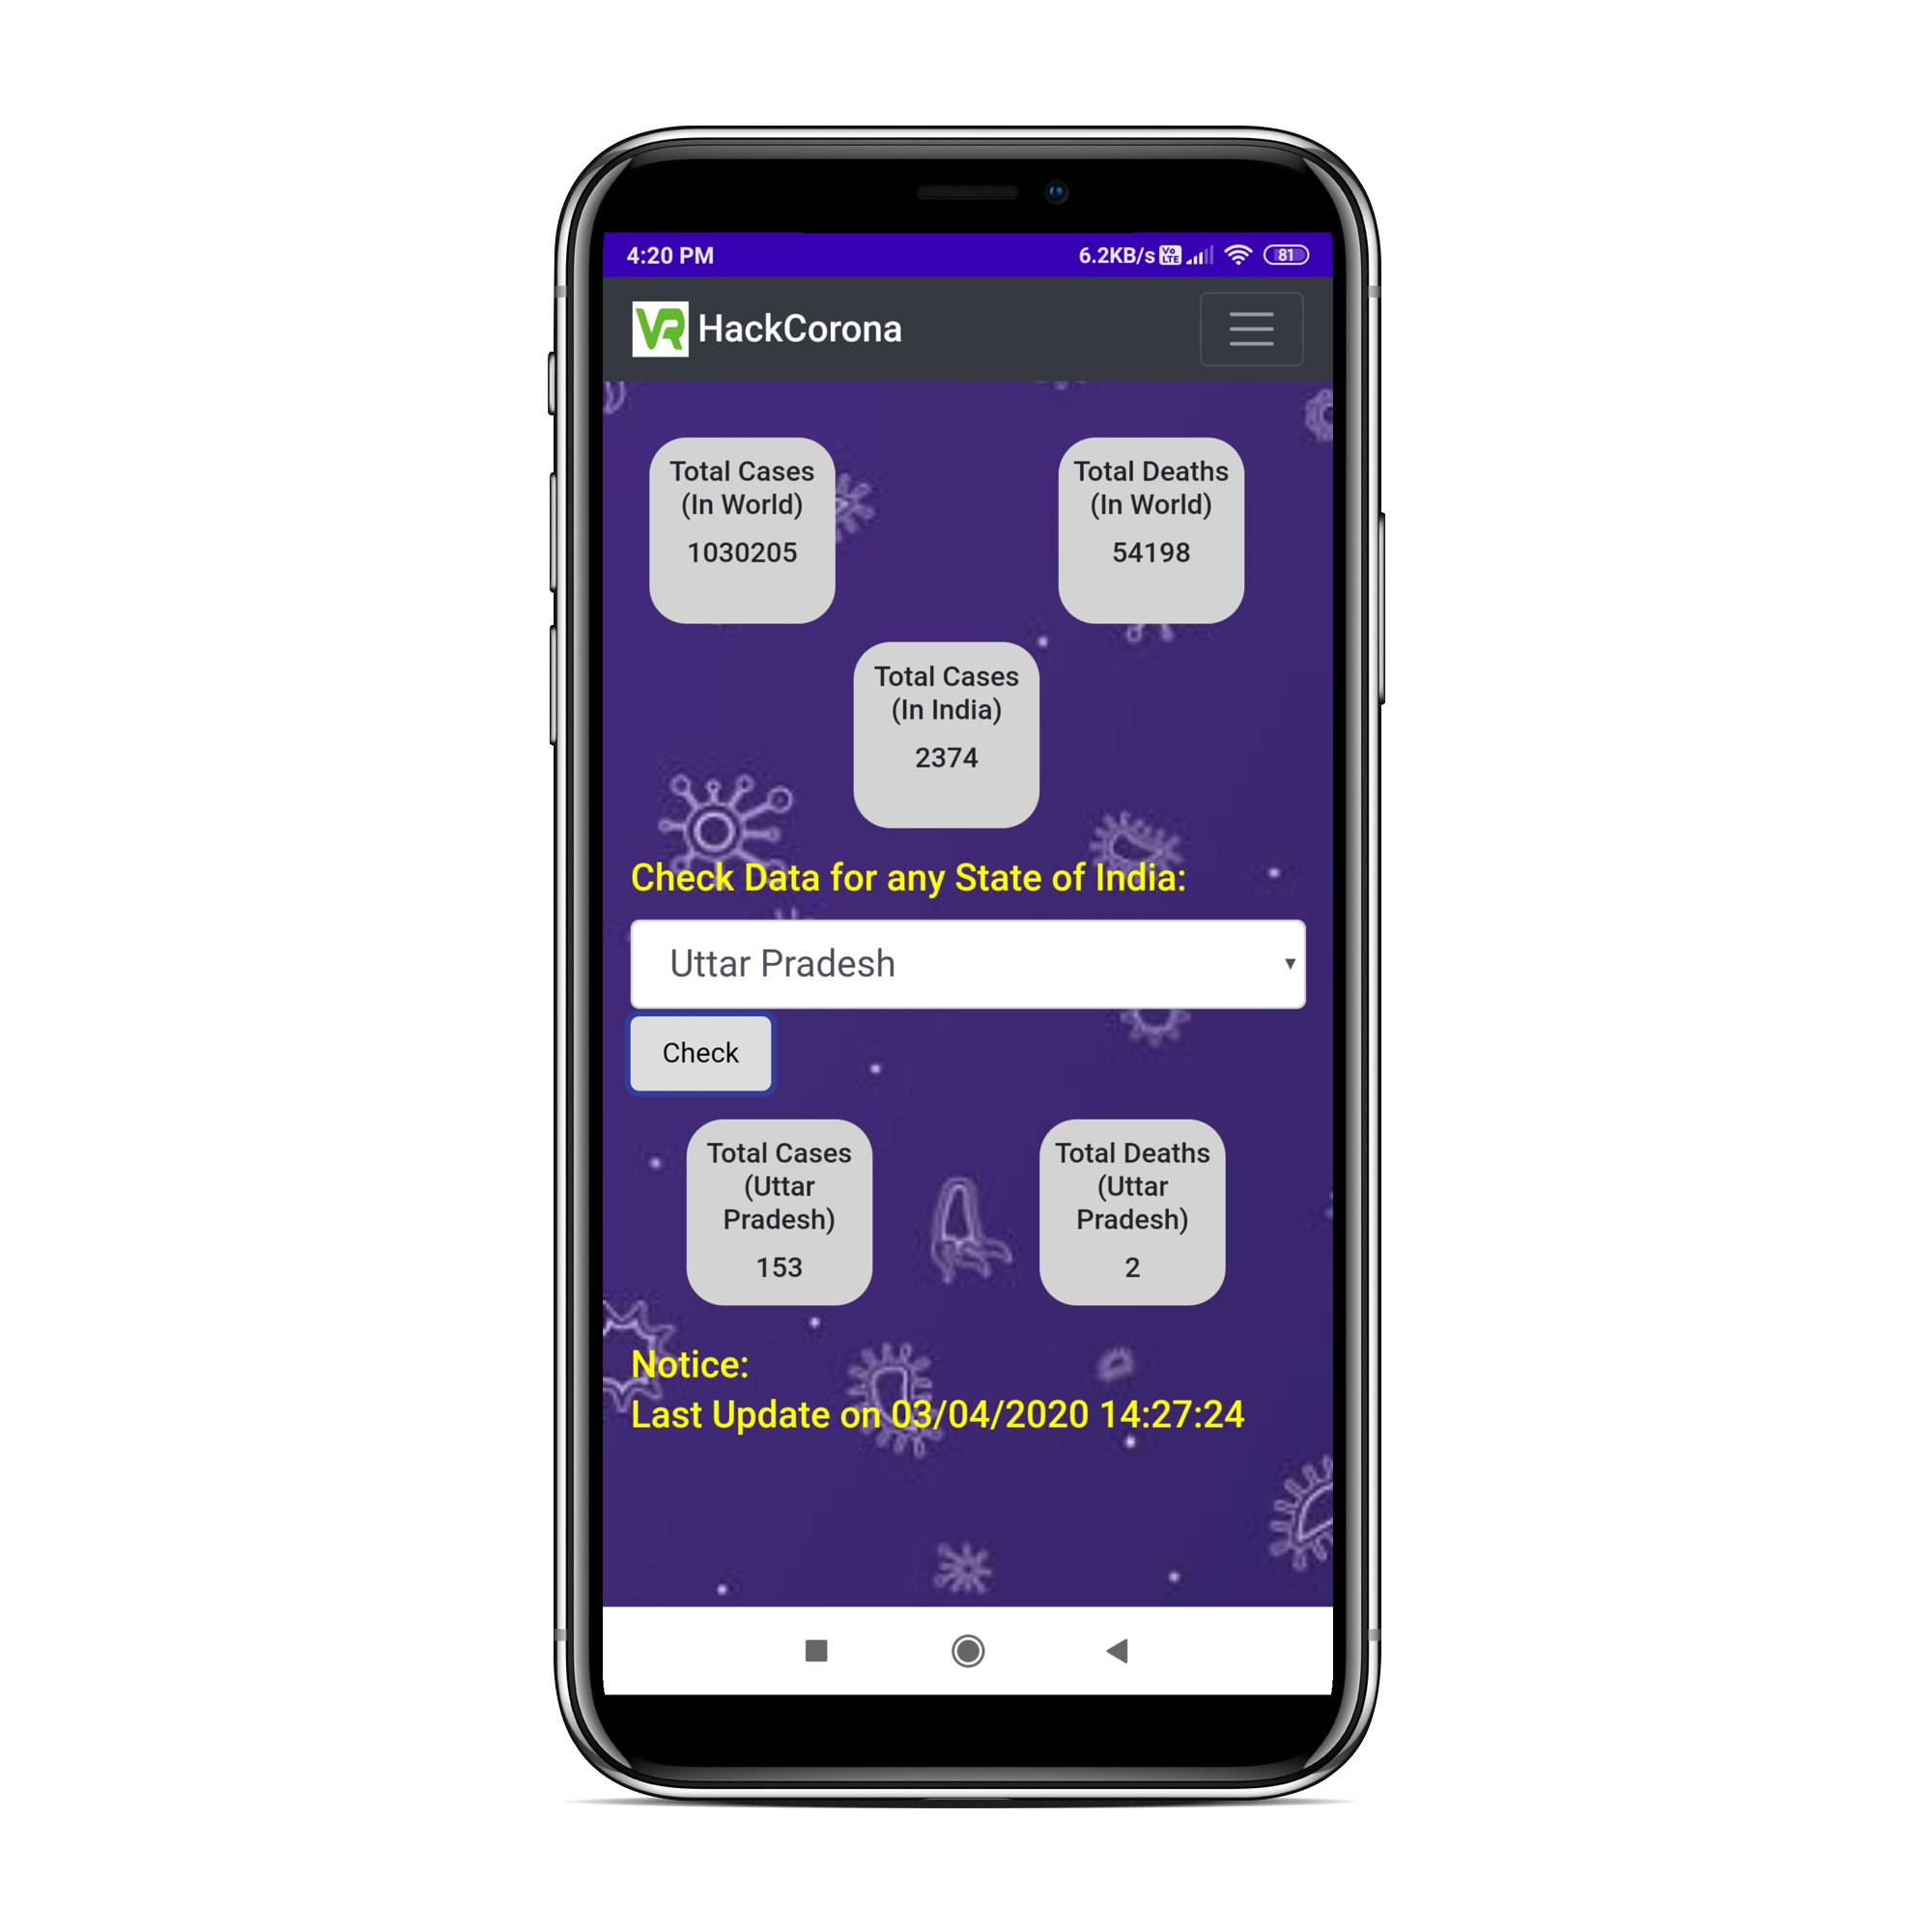
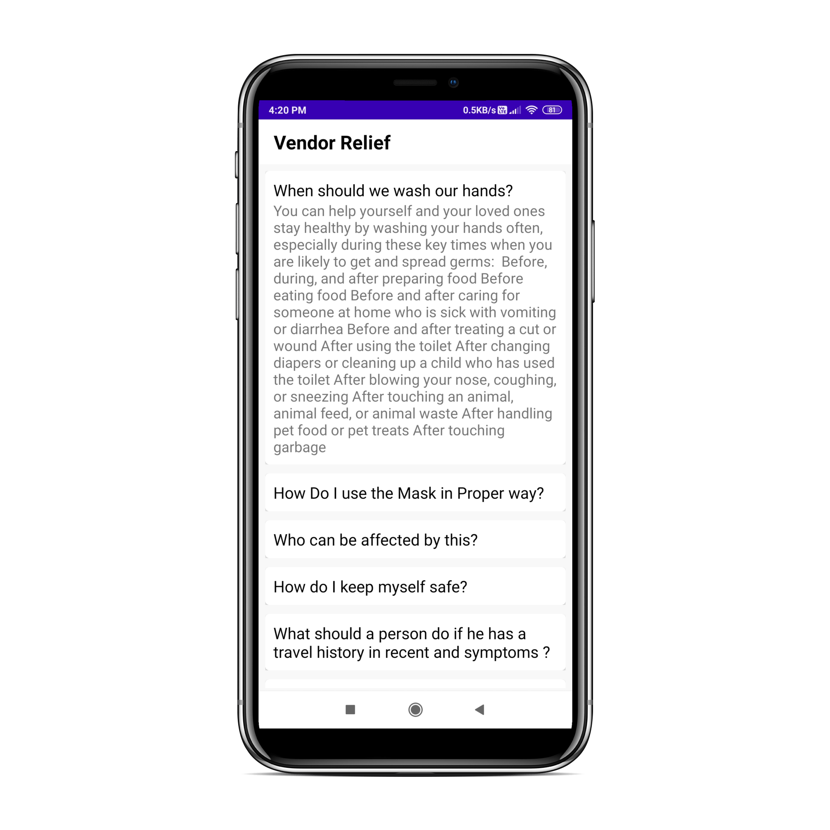
Screenshots of Vendor Relief App
Features of Vendor Relief :
Get details of the Vendor
Get RealTime Data of COVID-19
Prevention and Precautions

Slide 9
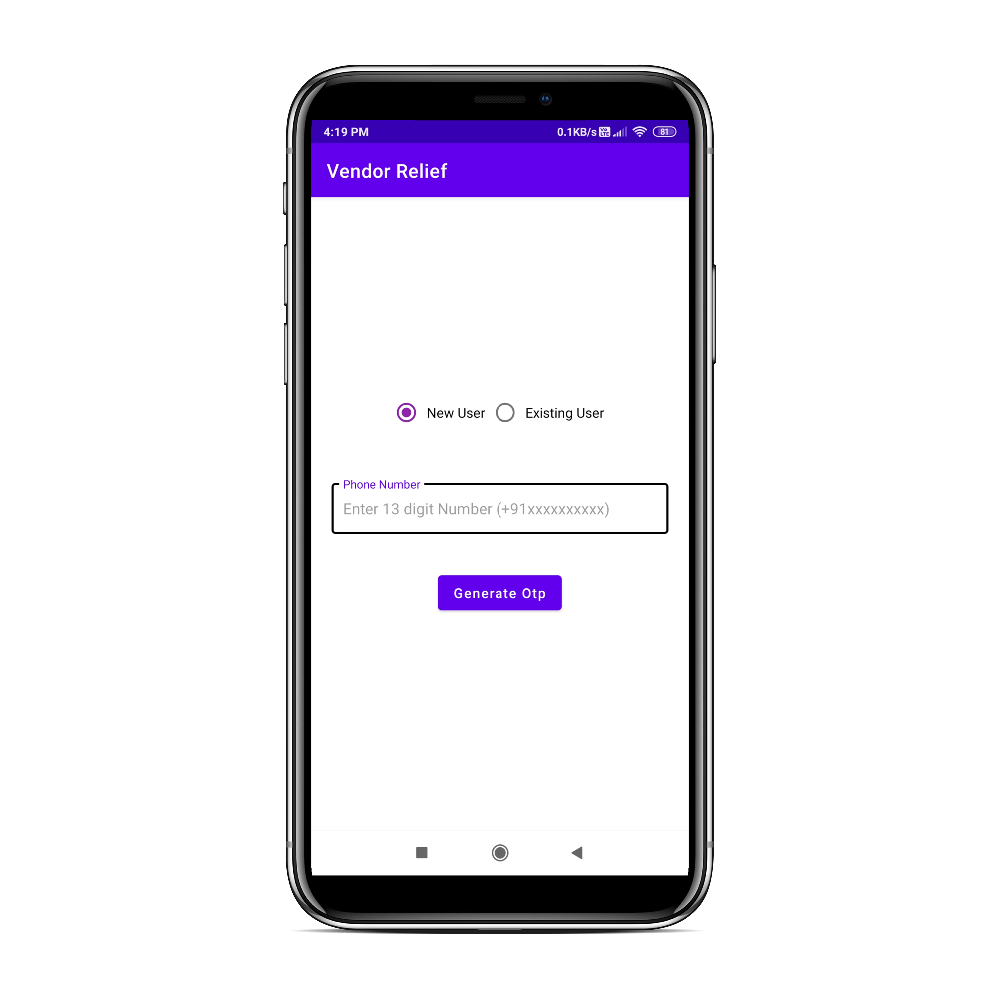
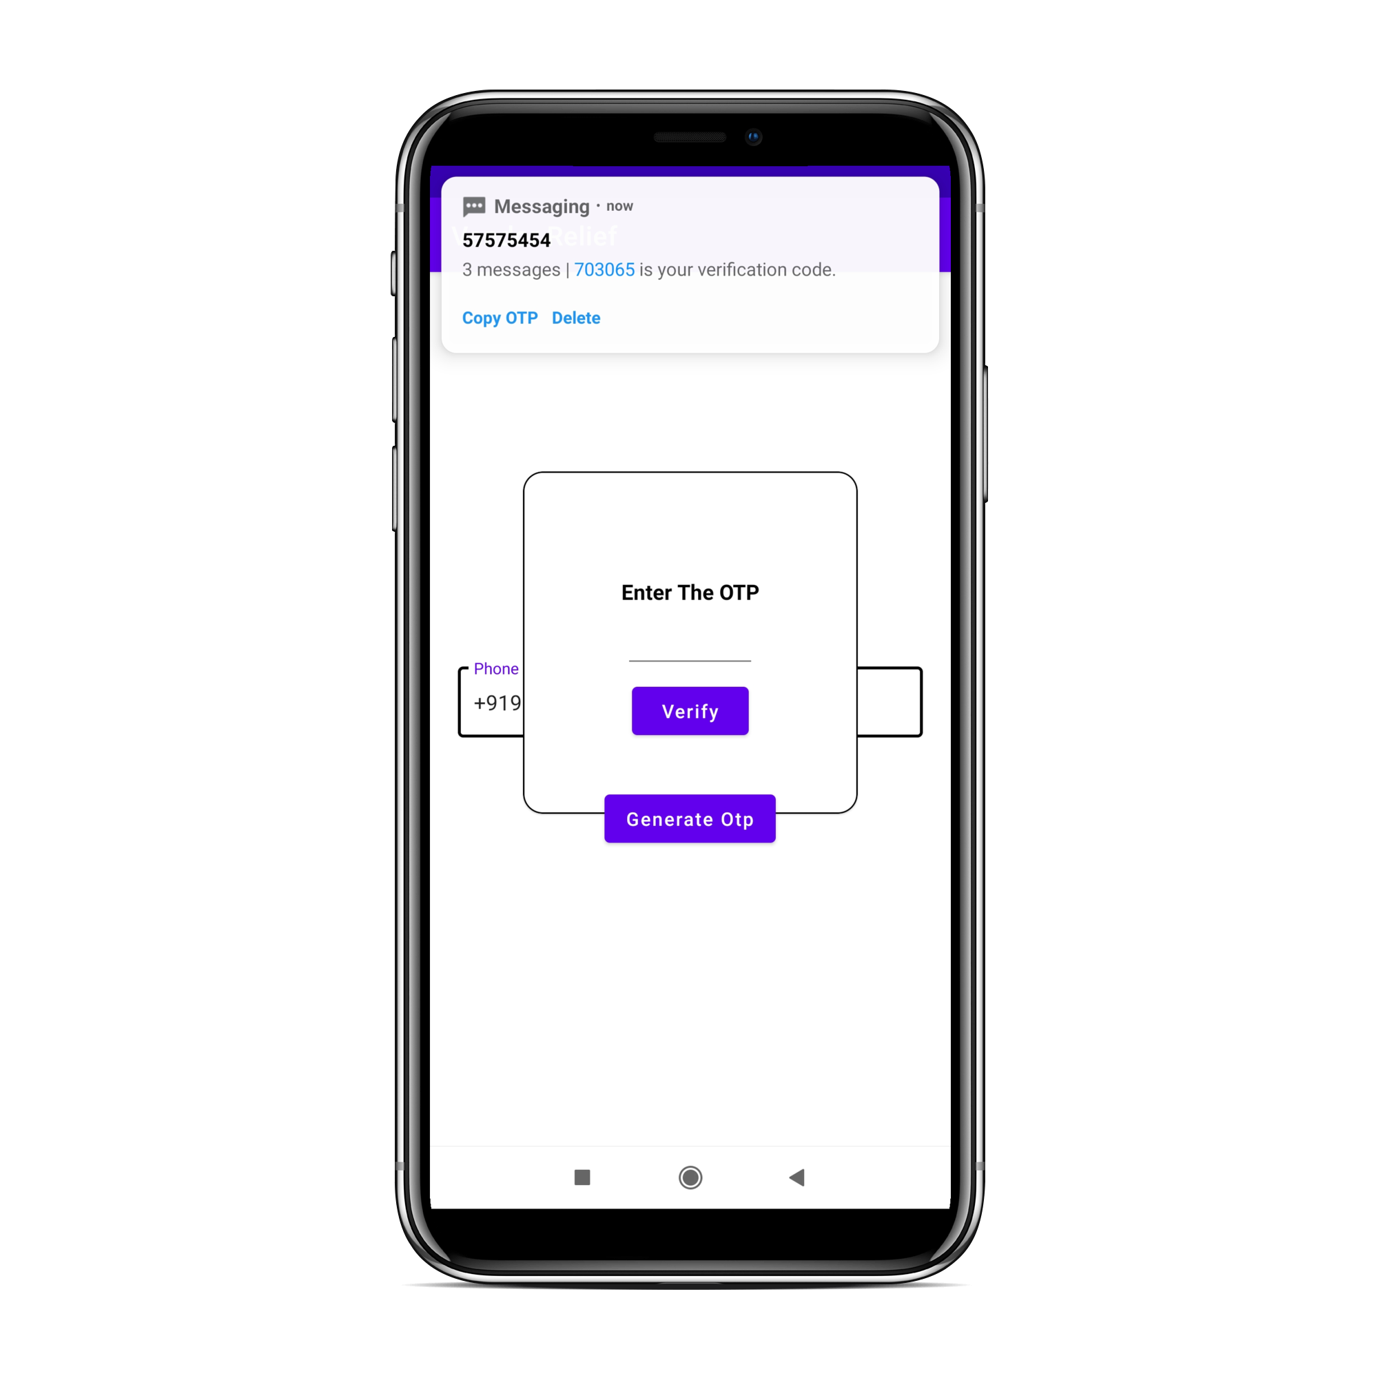
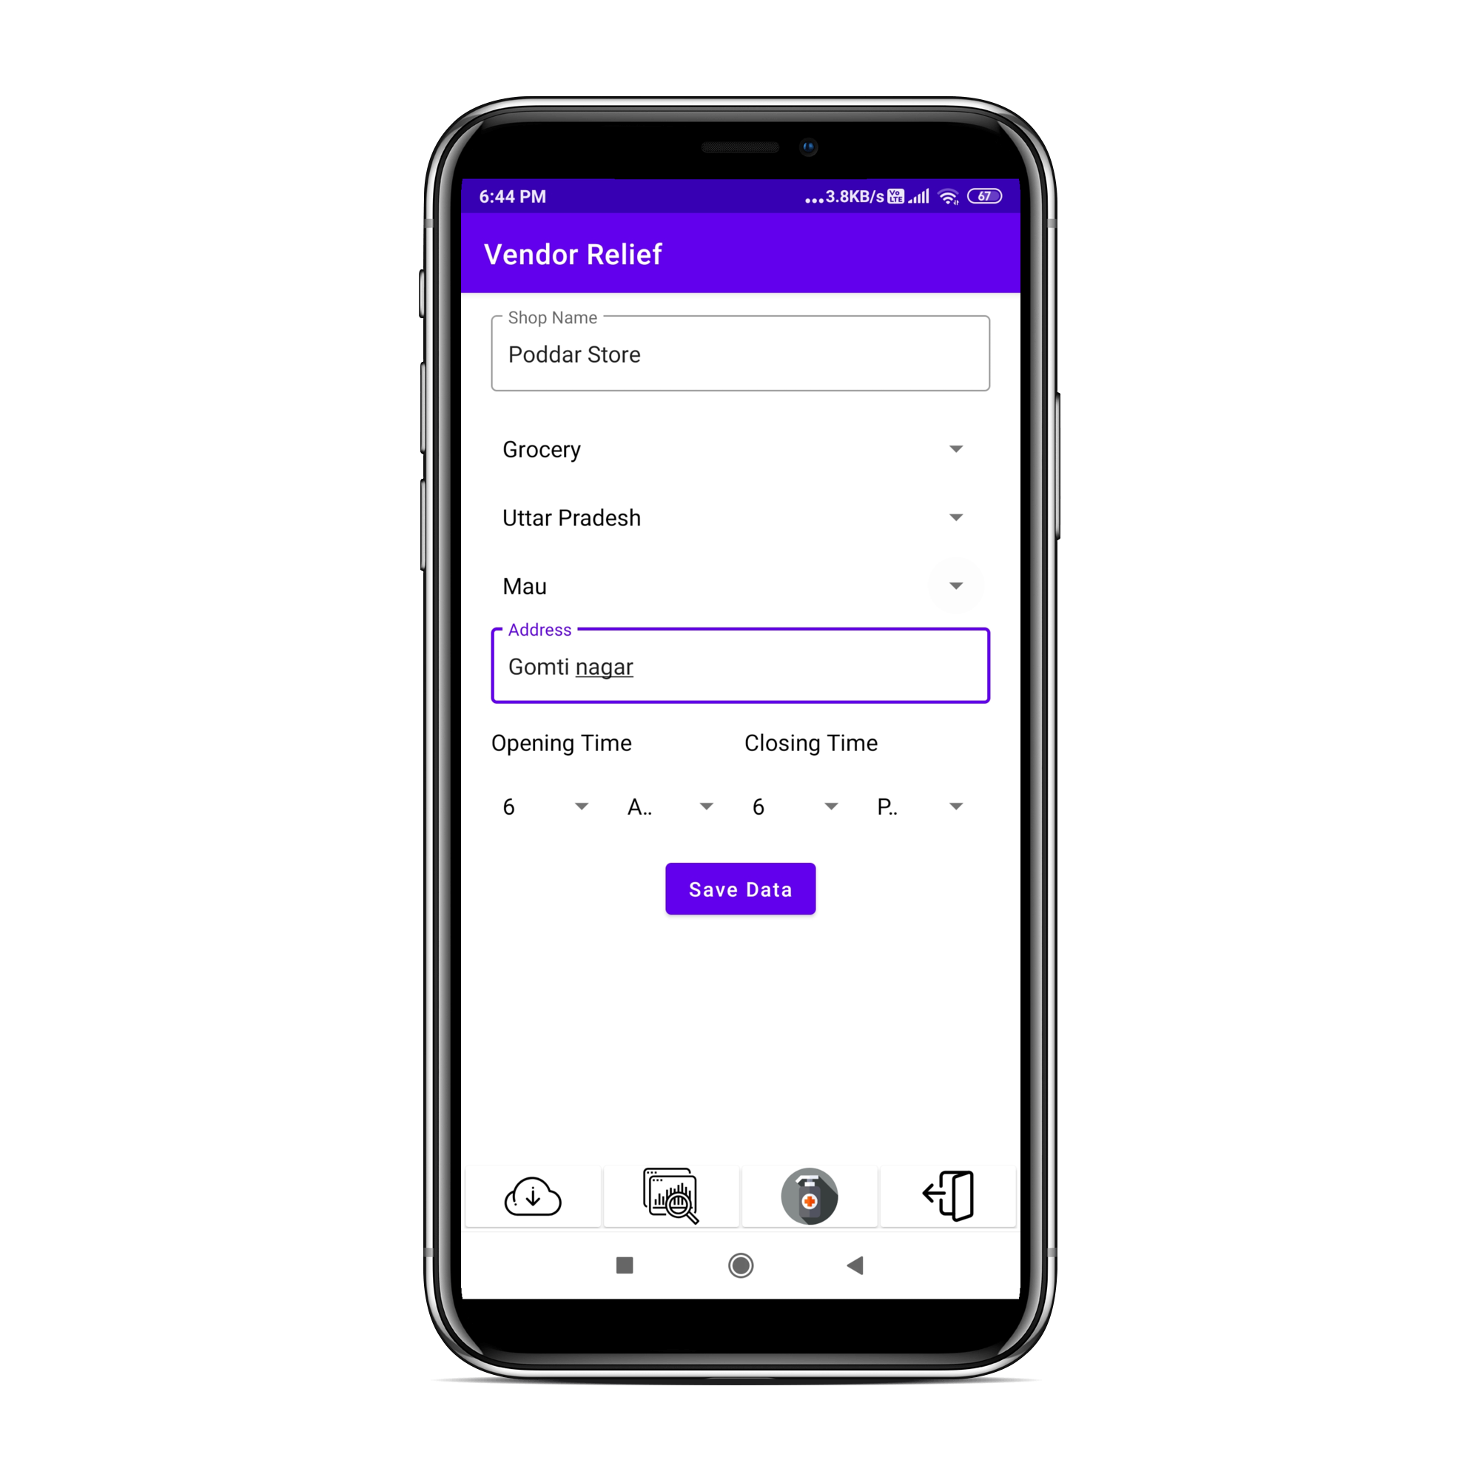
Screenshots of Vendor Relief App
Registration of new Vendor:
1)Enter the mobile Number
2)Verify the OTP
3)Enter the Details of Vendor

Slide 10
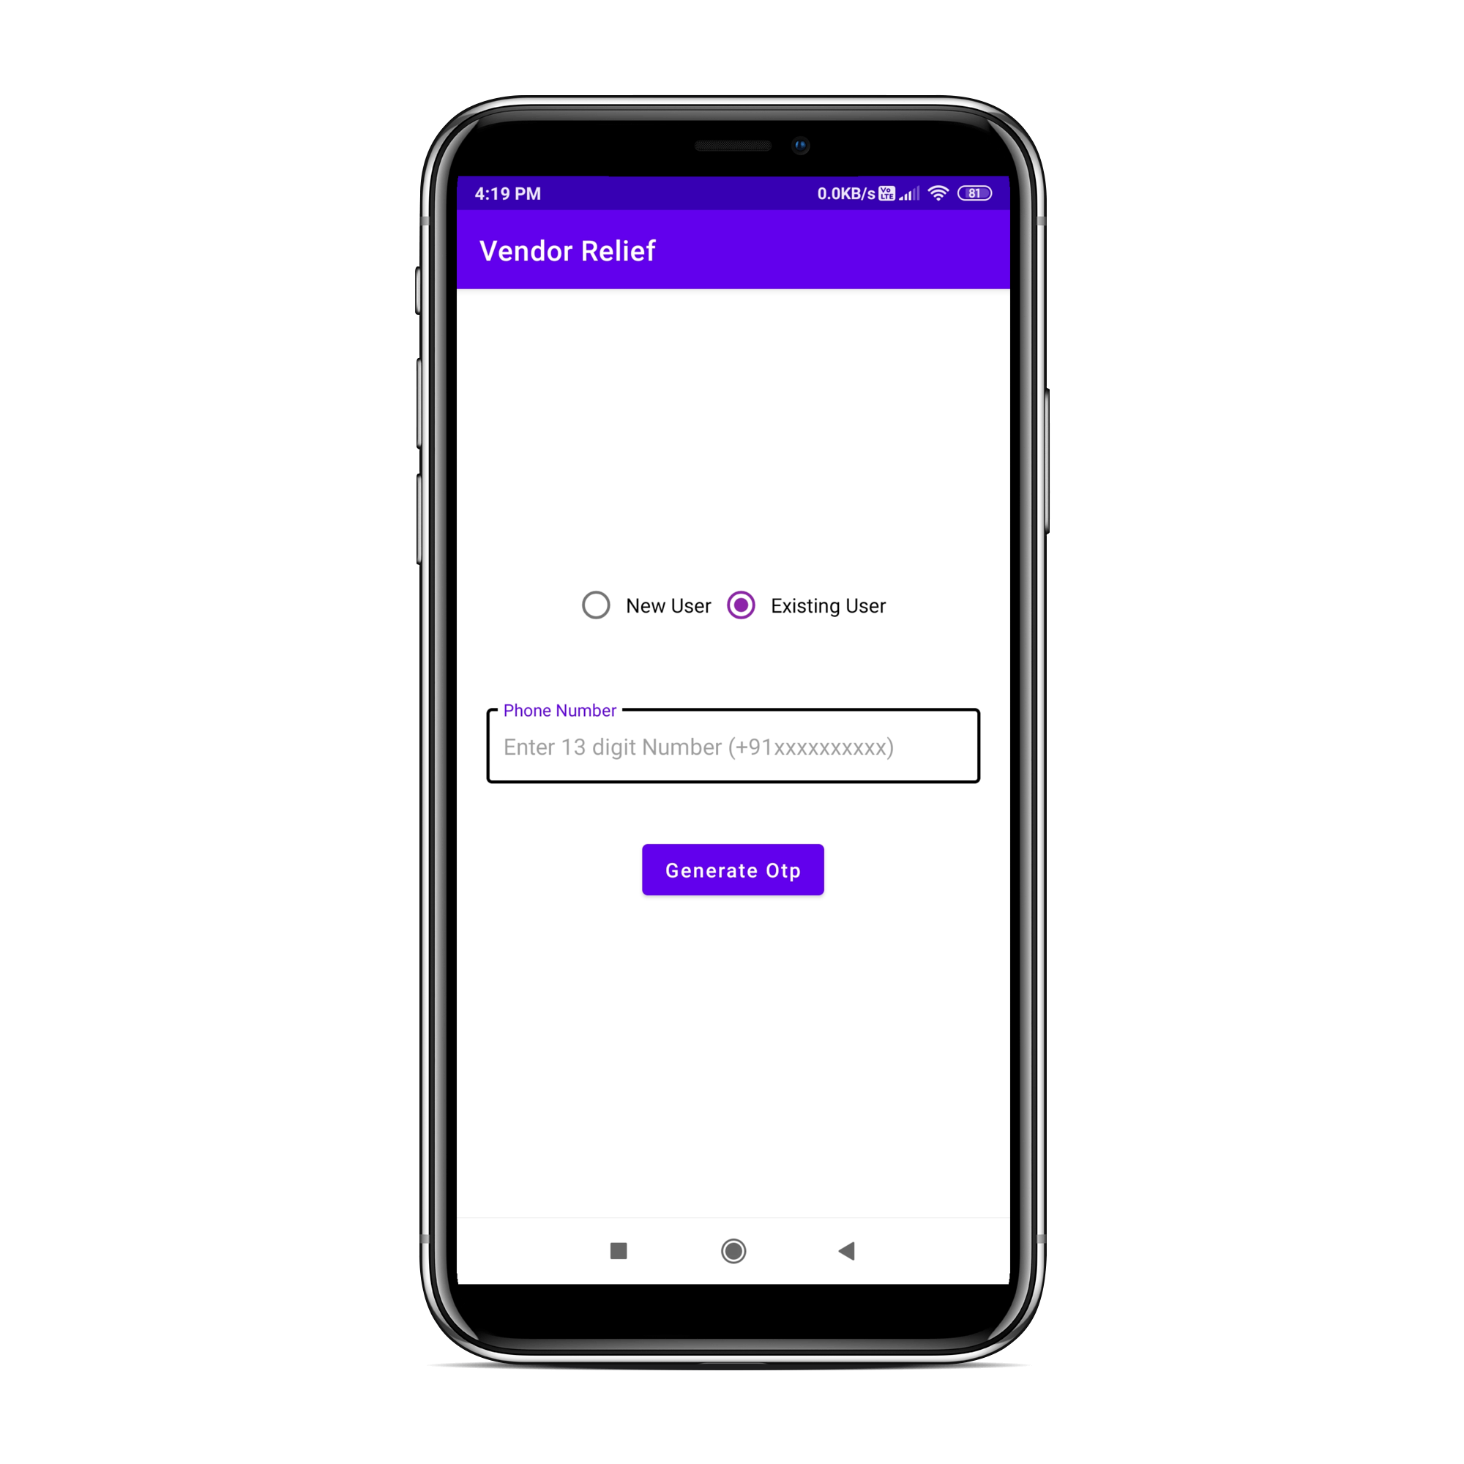
Screenshot of Vendor Relief App
Existing user updation:
1)Enter the mobile Number
2)Verify the OTP
3)Enter the Details of Vendor

Slide 11

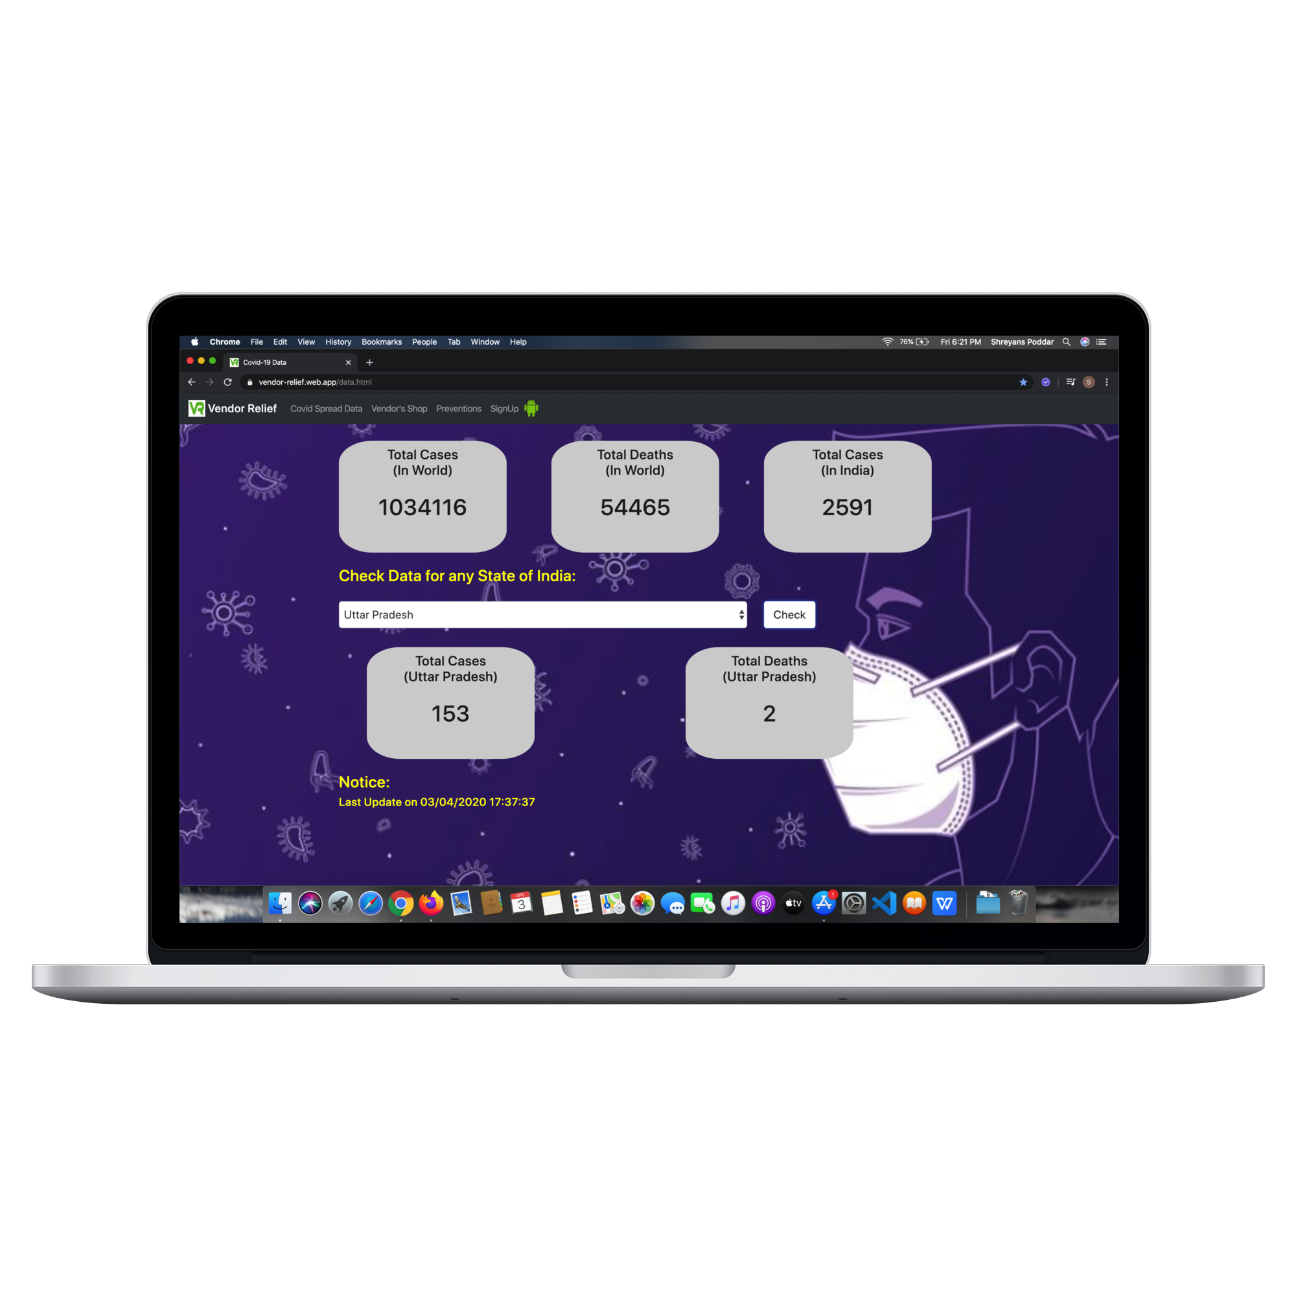
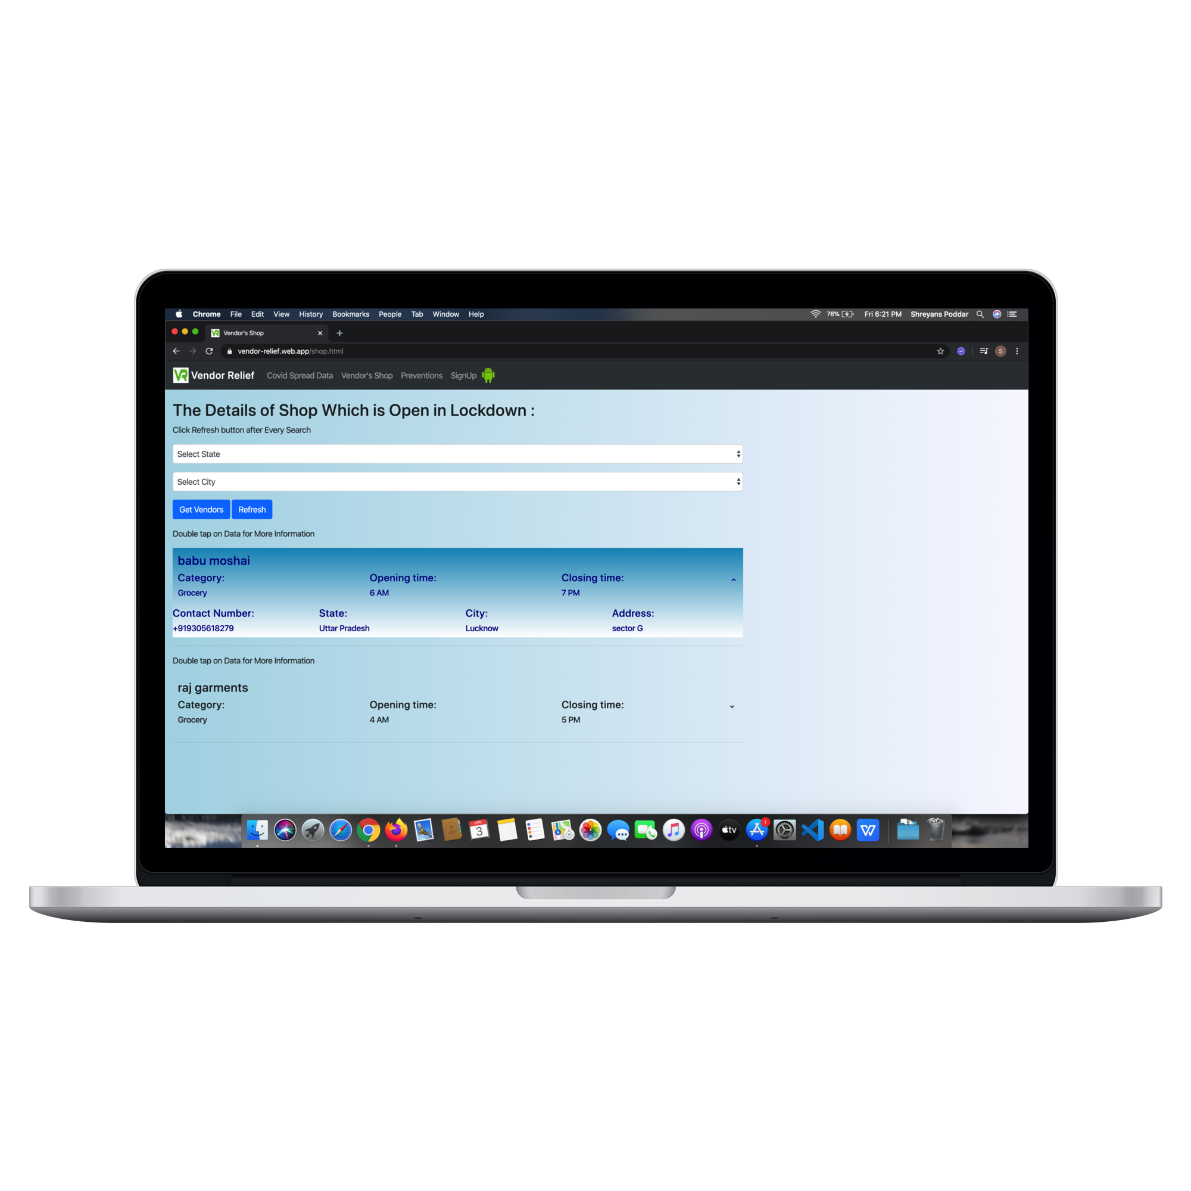
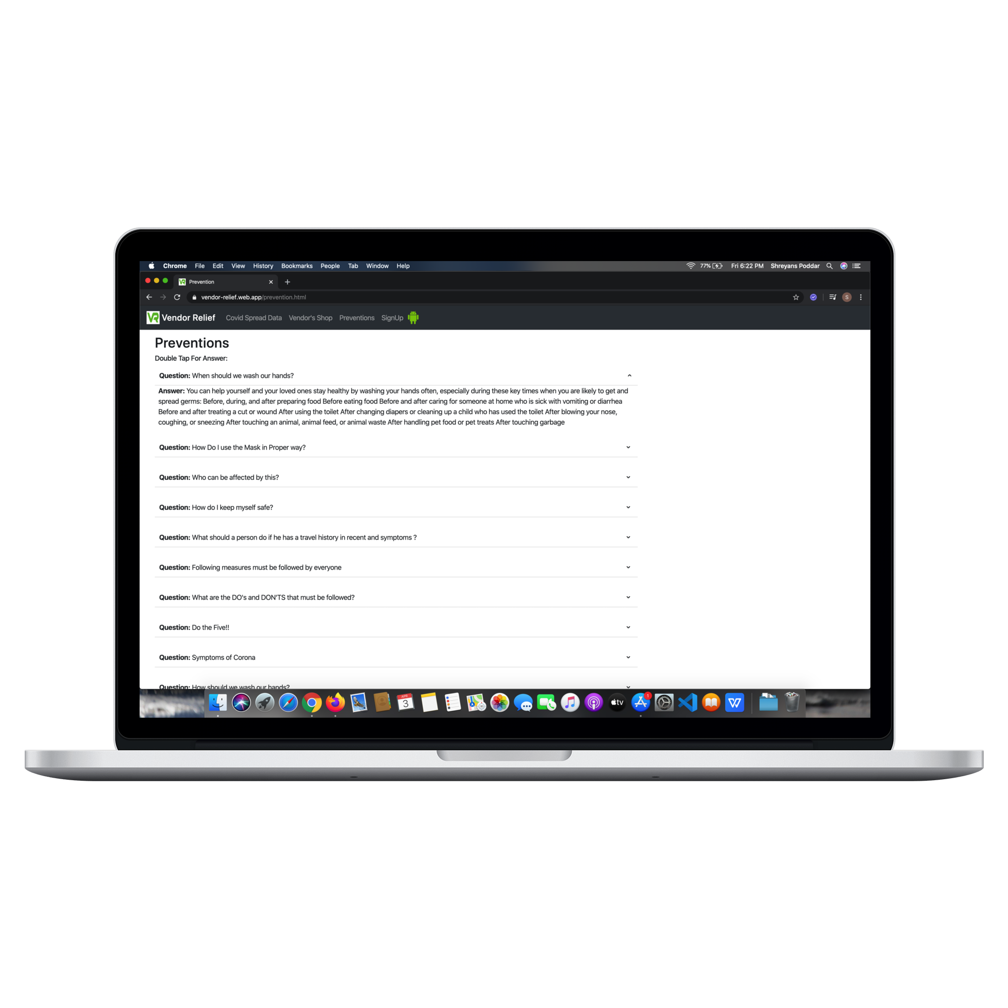
Screenshot of Vendor Relief web app
Home Page of Vendor Relief Web App
Realtime data of Covid-19
Get Vendor Details state and city wise
Prevention and Precaution of COVID-19

Slide 12
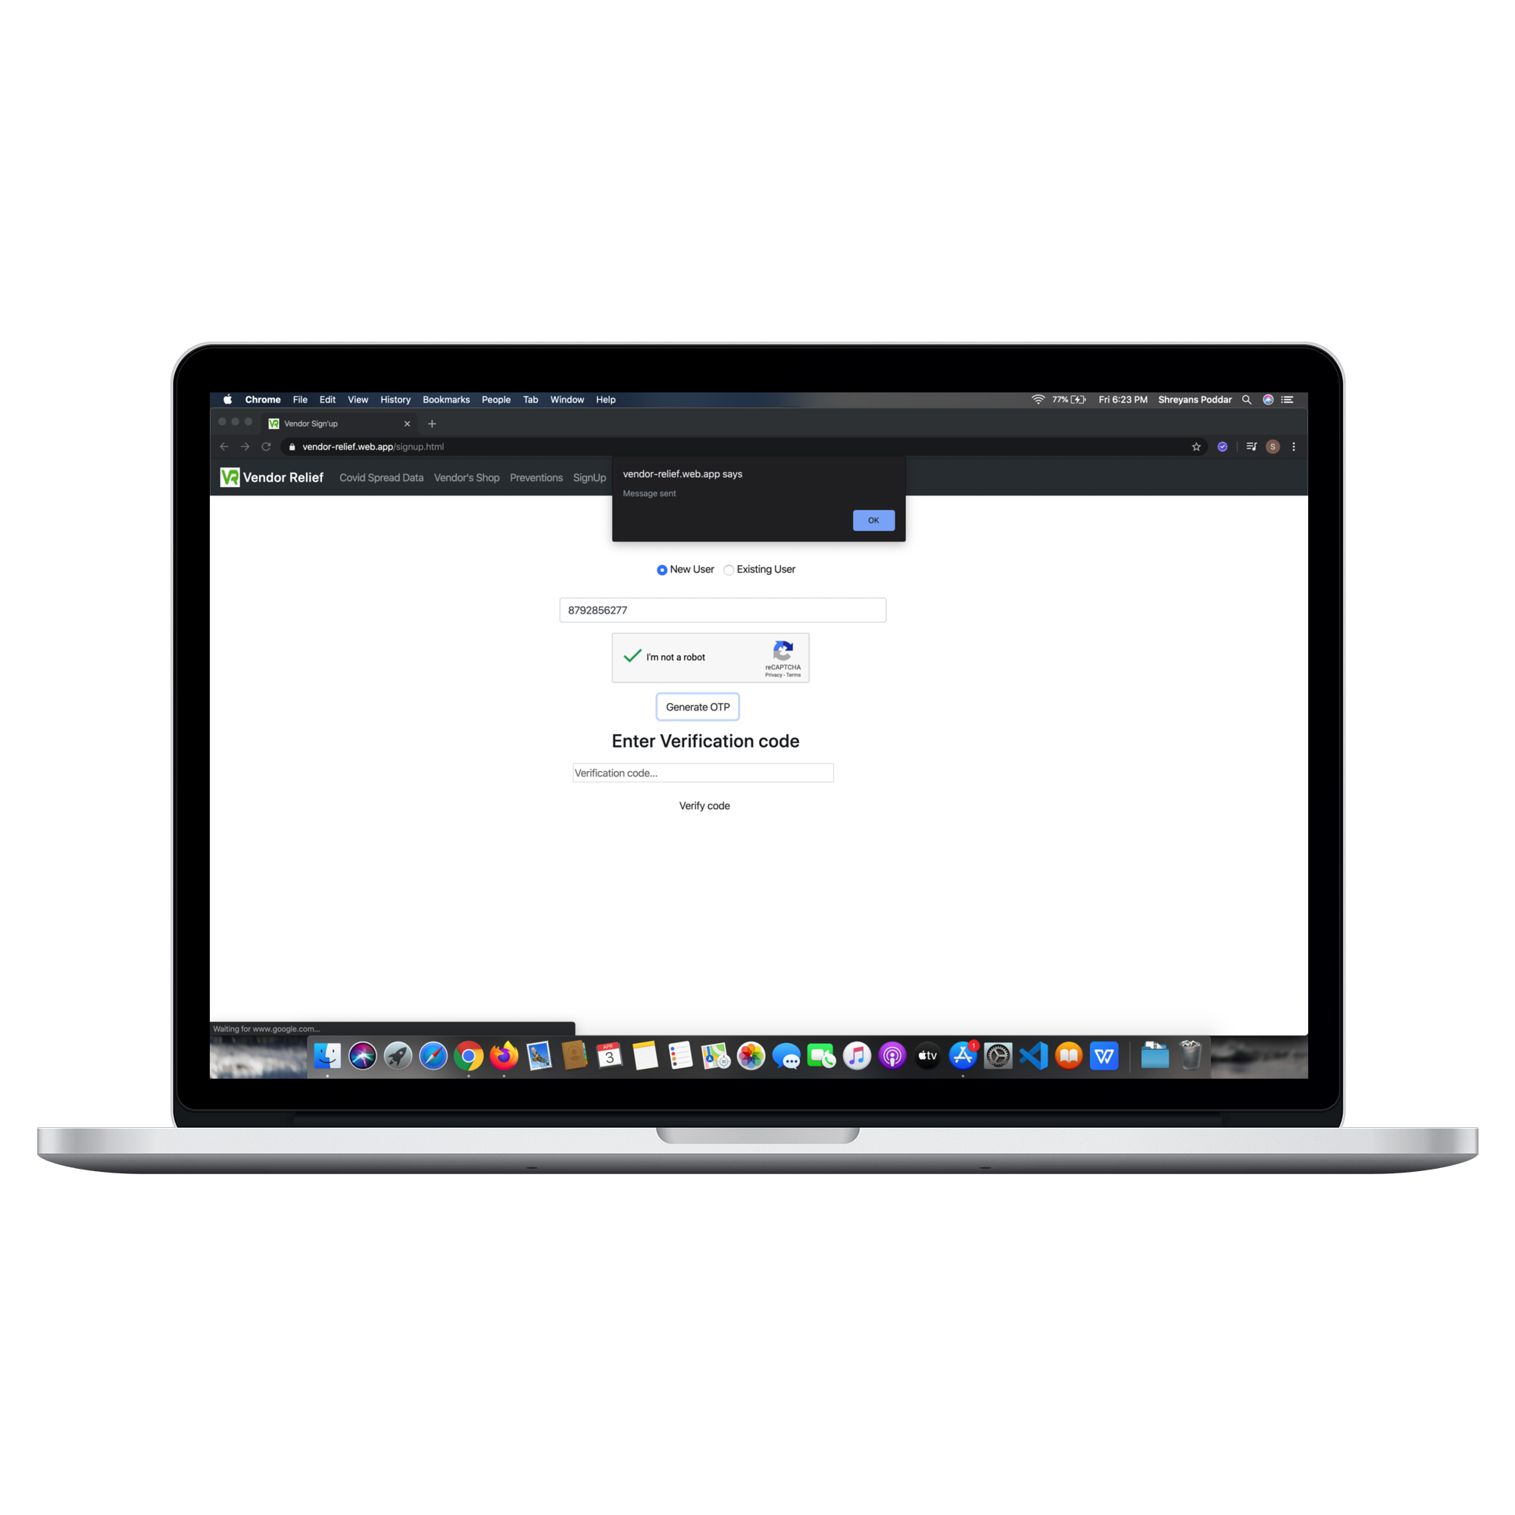
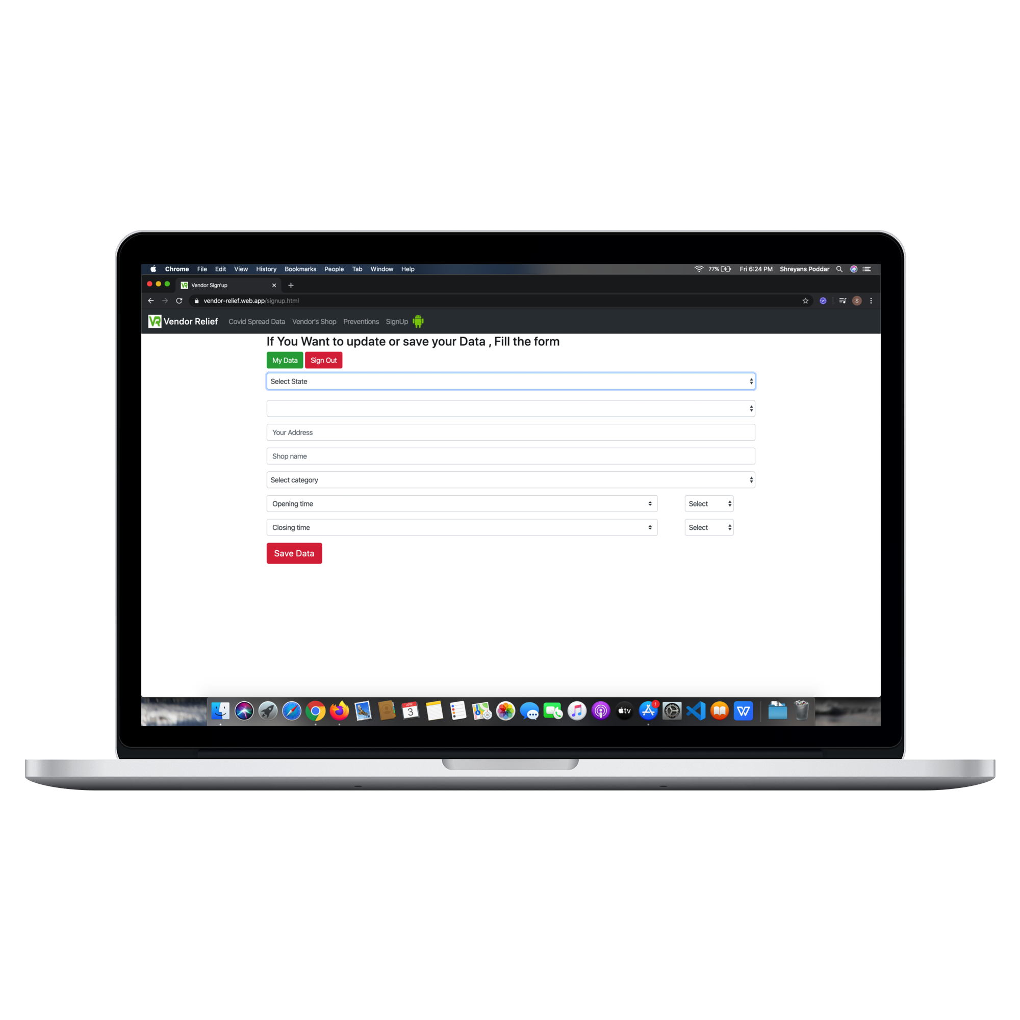
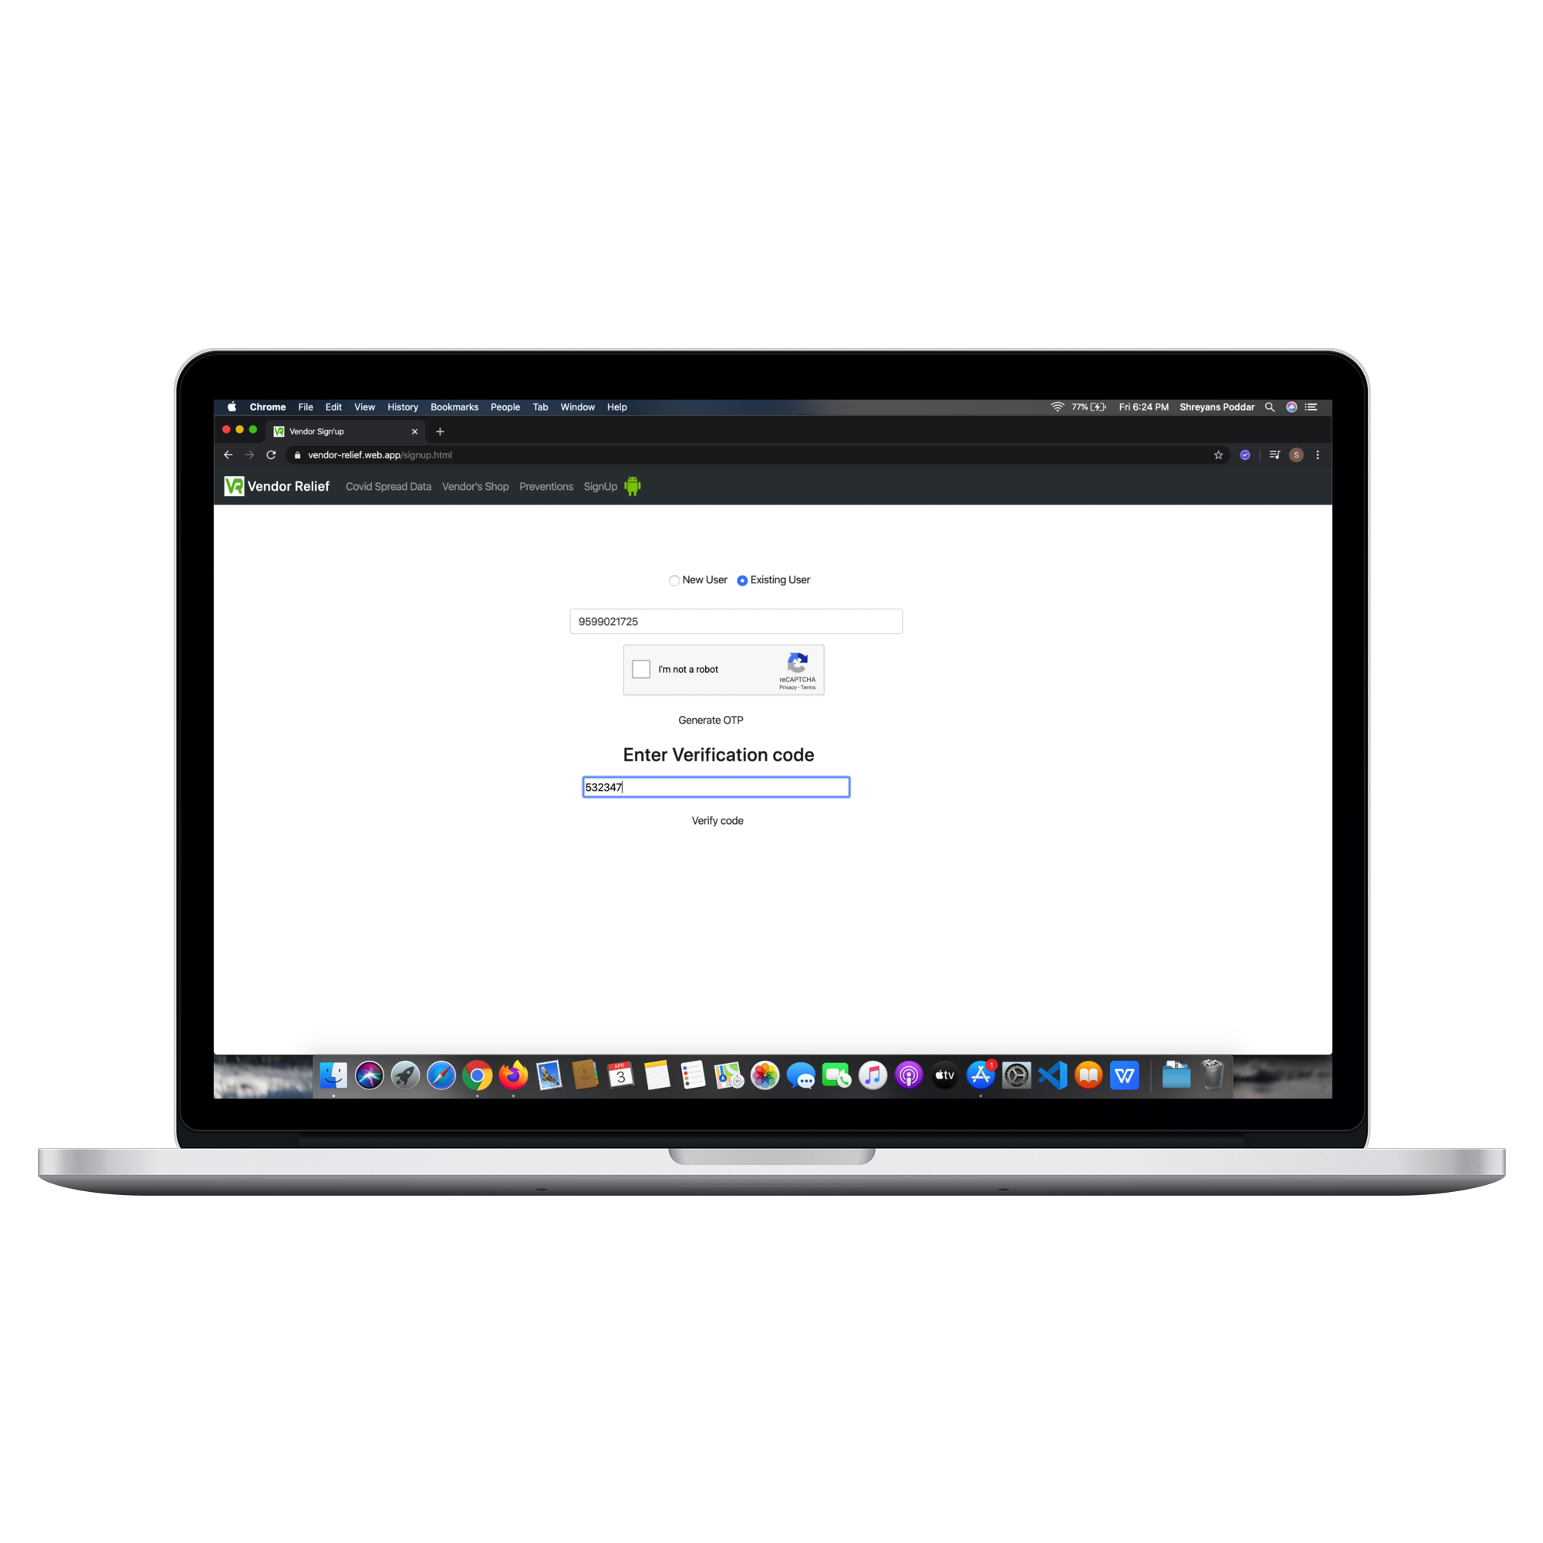
Screenshot of Vendor web app
Enter phone Number(New user)
Enter the Details of the Vendor
Enter phone Number(Existing User)
Enter the Details of the Vendor

Slide 13
Future prospectus
If this app goes to the government we can verify the local vendor by using their pan card and aadhar card details.
We can use Google Location API to let user input their shop address without hassle.
How to use manual guide to help the user , how to use the app.

Slide 14
Downloads
App Apk:
https://drive.google.com/uc?export=download&id=1l6meqnq8A0XX-6ZQcYWr-Qqz4wz38fX0 ( Link for the app’s APK)
https://drive.google.com/uc?export=download&id=1cDcxaAe2u5goKOXcKNOiYG7n6eWwVC8m (download the JSON File along also)
Website Link:
https://vendor-relief.web.app/

